Slide 1
Summerhouse Example
Business Intelligence & Analytics

Slide 2
A trip to the summer house
Introduce several concepts such as
Key Performance Indicators (KPIs)
Performance management
Information requirements
Dashboards
Route is 60 miles long and is expected to take 60 minutes

Slide 3
Analytics must answer the following
Status – have we gone far enough in relation to how long we’ve been on the road
Trend – are we accelerating up or down, or is our speed constant?
Projection – given our speed and how far we’ve gone, will we reach the summerhouse at the expected time?

Slide 4
Specification of requirements
Goal – Drive 60 miles in 60 minutes
KPI = Actual Miles / Budgeted miles

Slide 5
Specification of requirements
Goal – Drive 60 miles in 60 minutes
>1 if we’re ahead of our target
= 1 if we’re exactly where we should be
< 1 if we’re behind schedule
KPI = Actual Miles / Budgeted miles

Slide 6
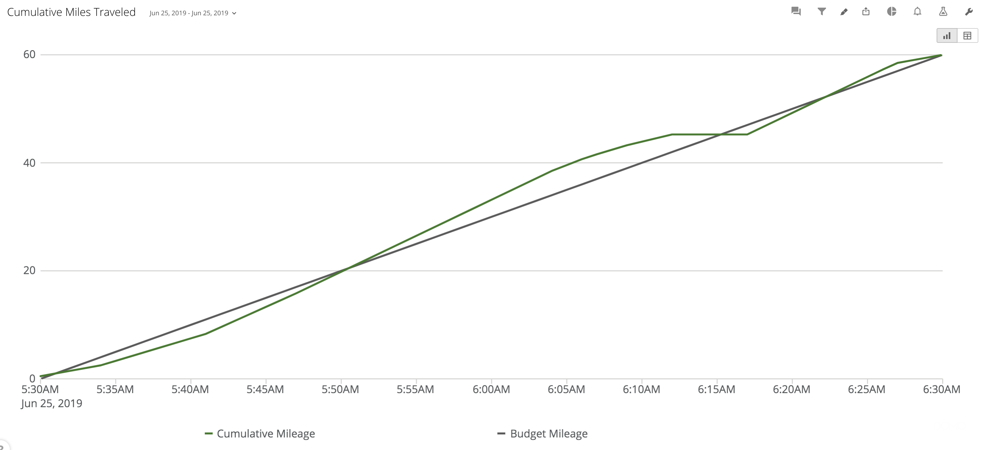

Slide 7
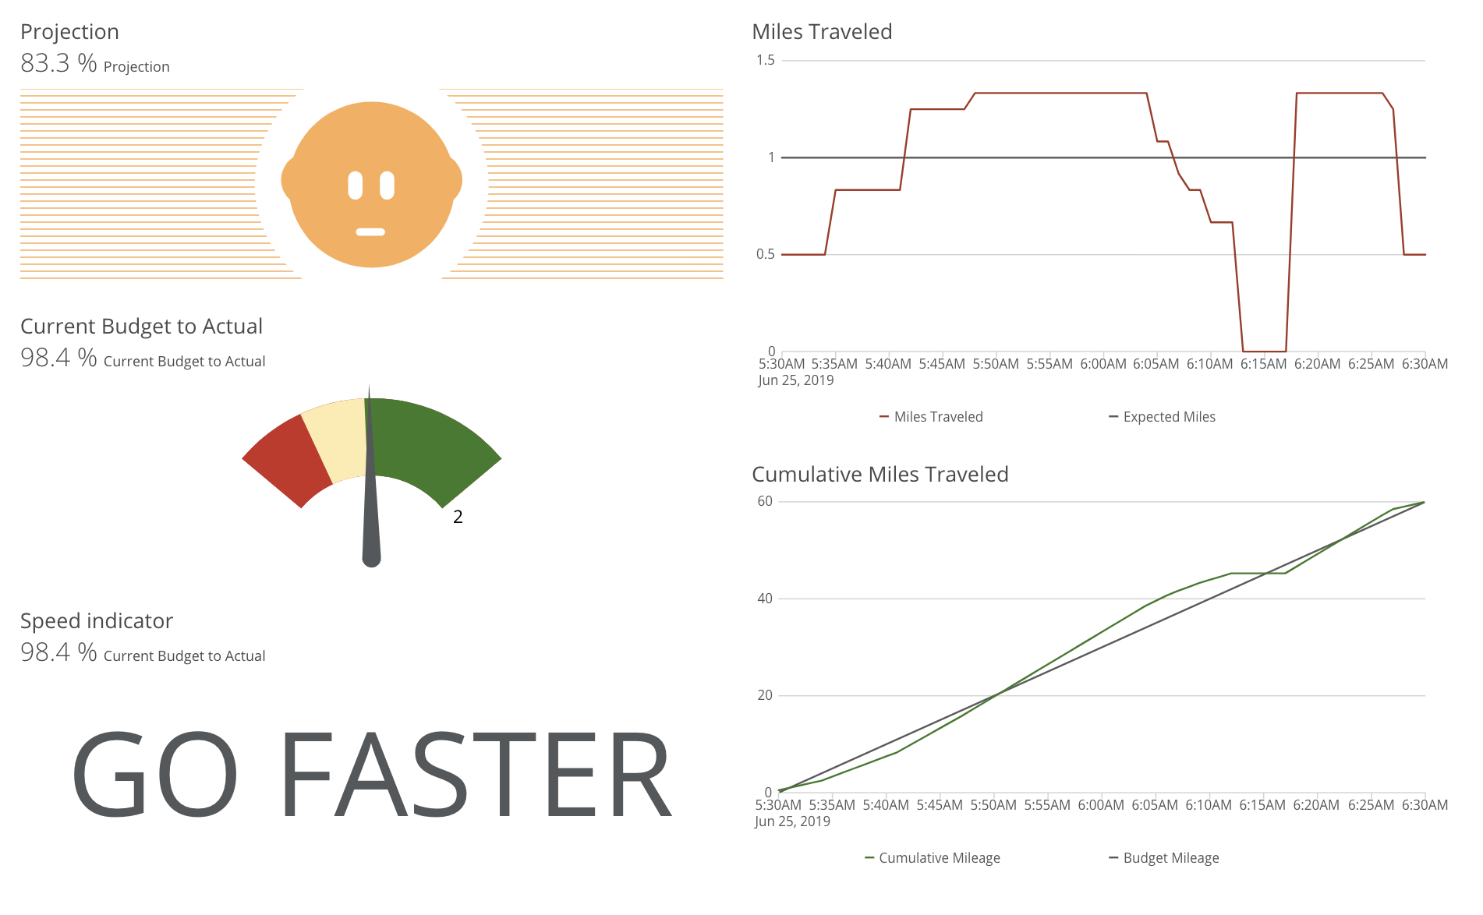

Slide 8
Trends showing our progress over time

Slide 9
Trends showing our progress over time
Indicator for whether we need to speed up or not

Slide 10
Gauge showing cumulative progress
Trends showing our progress over time
Indicator for whether we need to speed up or not

Slide 11
Projection showing if we’ll make it on time given our current speed and location
Gauge showing cumulative progress
Trends showing our progress over time
Indicator for whether we need to speed up or not

Slide 12
Projection showing if we’ll make it on time given our current speed and location
Gauge showing cumulative progress
Trends showing our progress over time
Indicator for whether we need to speed up or not

Slide 13
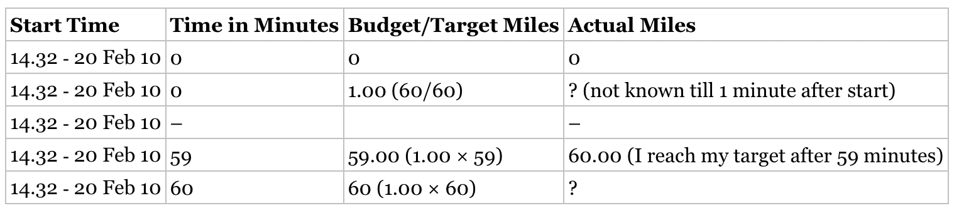
Base table

Slide 14
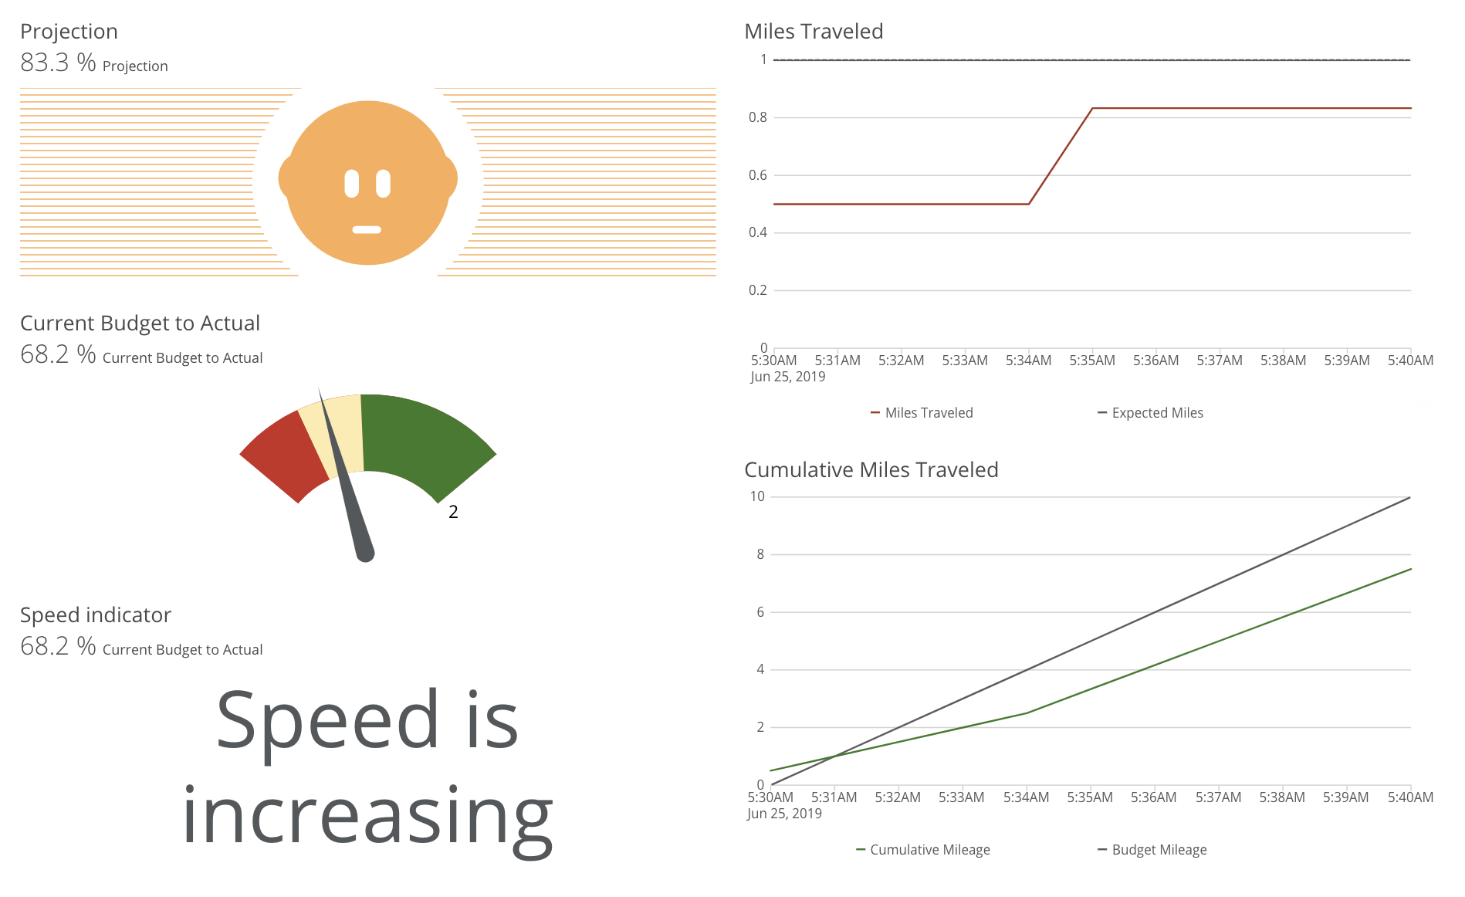
Start on our trip

Slide 15
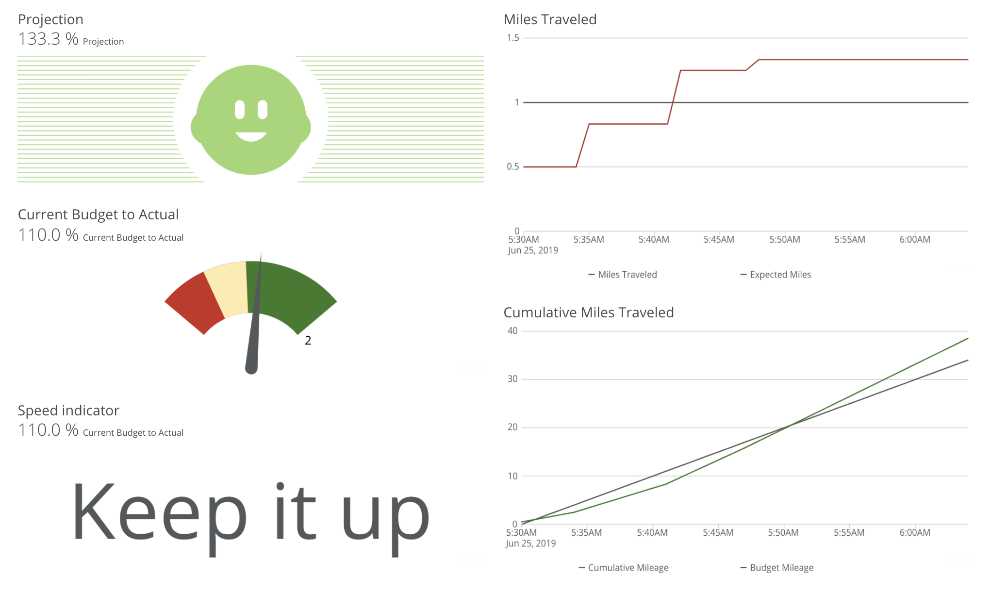
Make it to the freeway

Slide 16
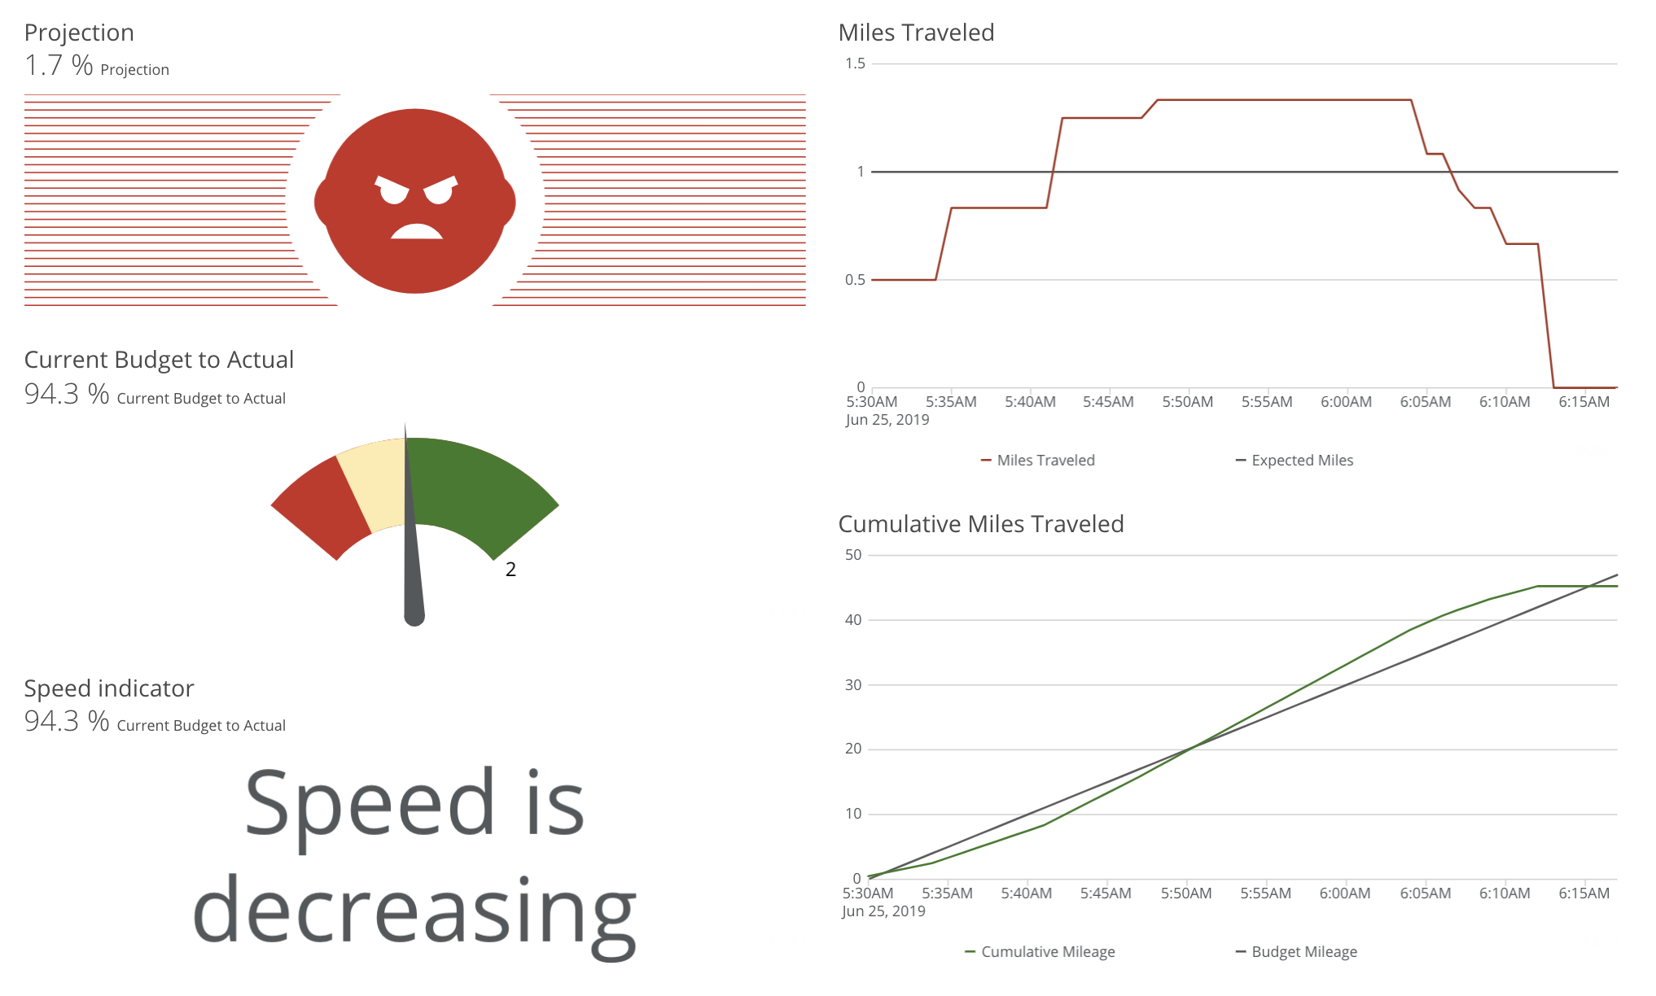
Stuck in traffic

Slide 17
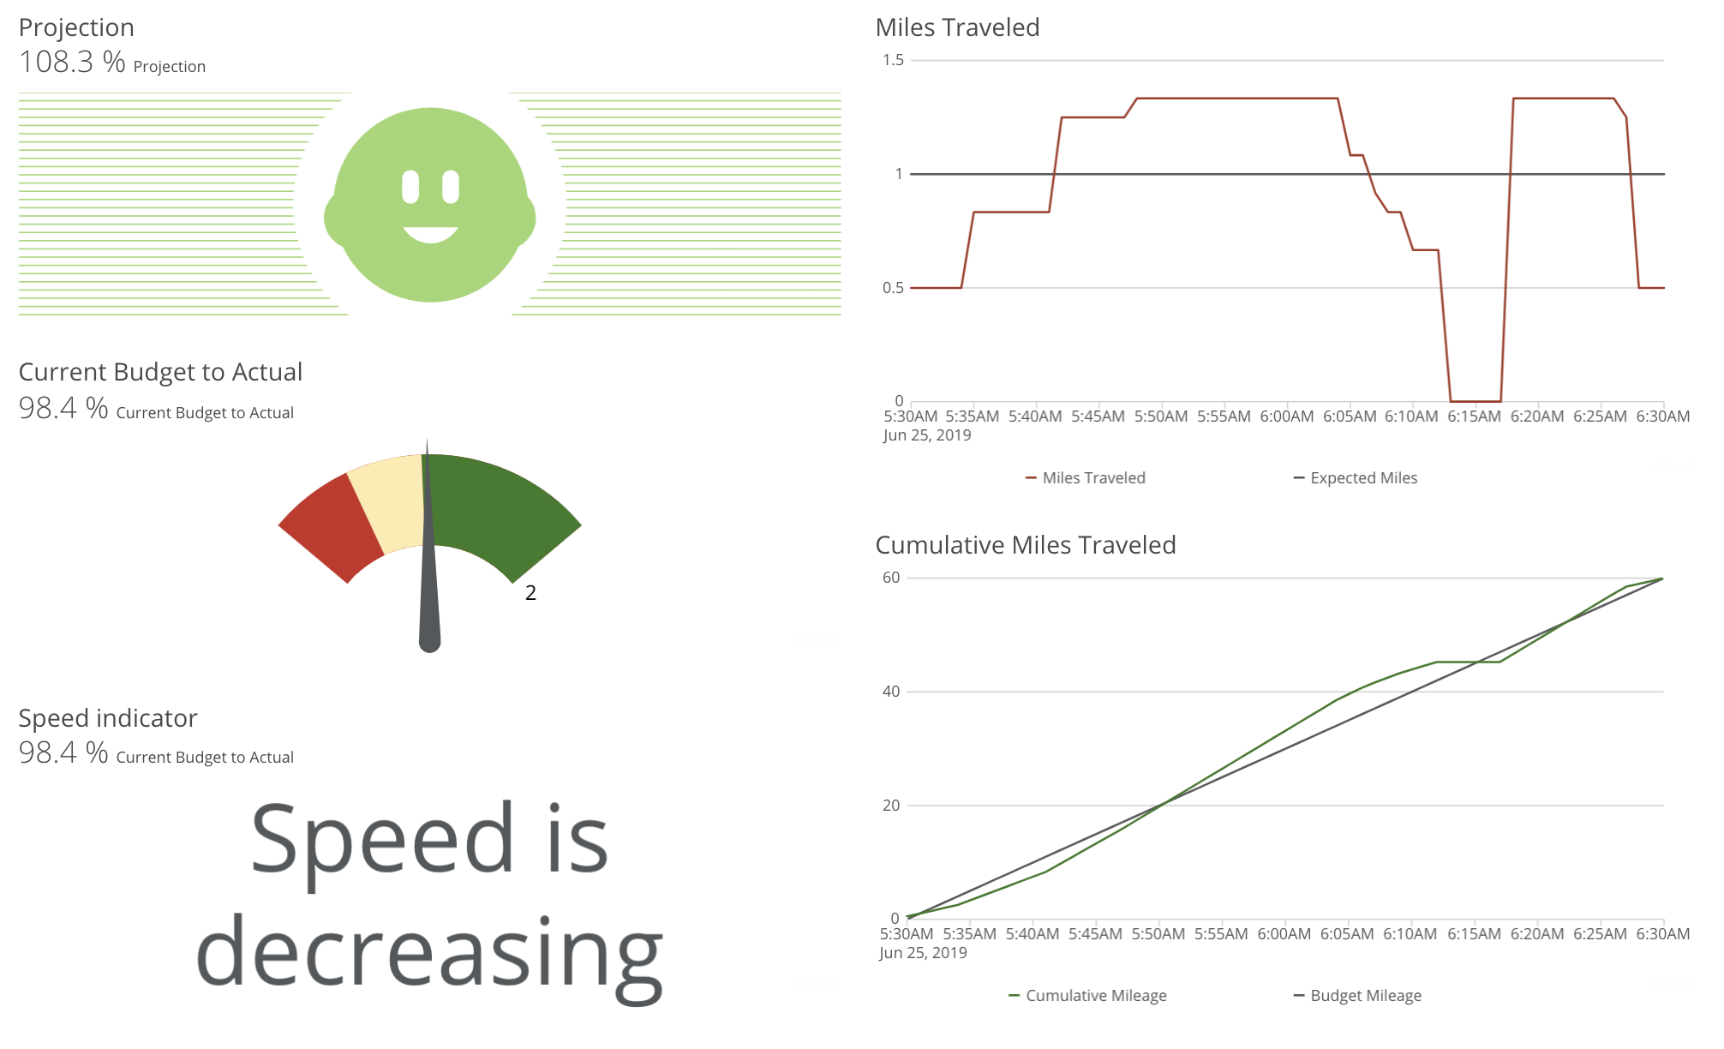
Exiting traffic and arriving

Slide 18
A note about KPIs
KPIs describe the relationship between the organization and its main objectives
Describe when the company is doing well and when it is off track
The existence of KPIs along with their associated targets allows the business to adjust tactics (keeping strategy fixed)
Provide the organization with a memory so learning can be derived from projects

Slide 19
Not achieving targets
What can we learn when KPIs are not meeting their targets
Lack of strategic focus
KPI is not visible to relevant staff
Visible but no one cares
Strategy has shifted
Mistrust in the data
Lack of competency
Business executing correctly but KPI is not reaching the desired level
Need to research competencies necessary to perform task well and competencies present in the business
Changing environment
Are we operating under different conditions than when strategy developed?
Were the targets set inappropriately?

Slide 20
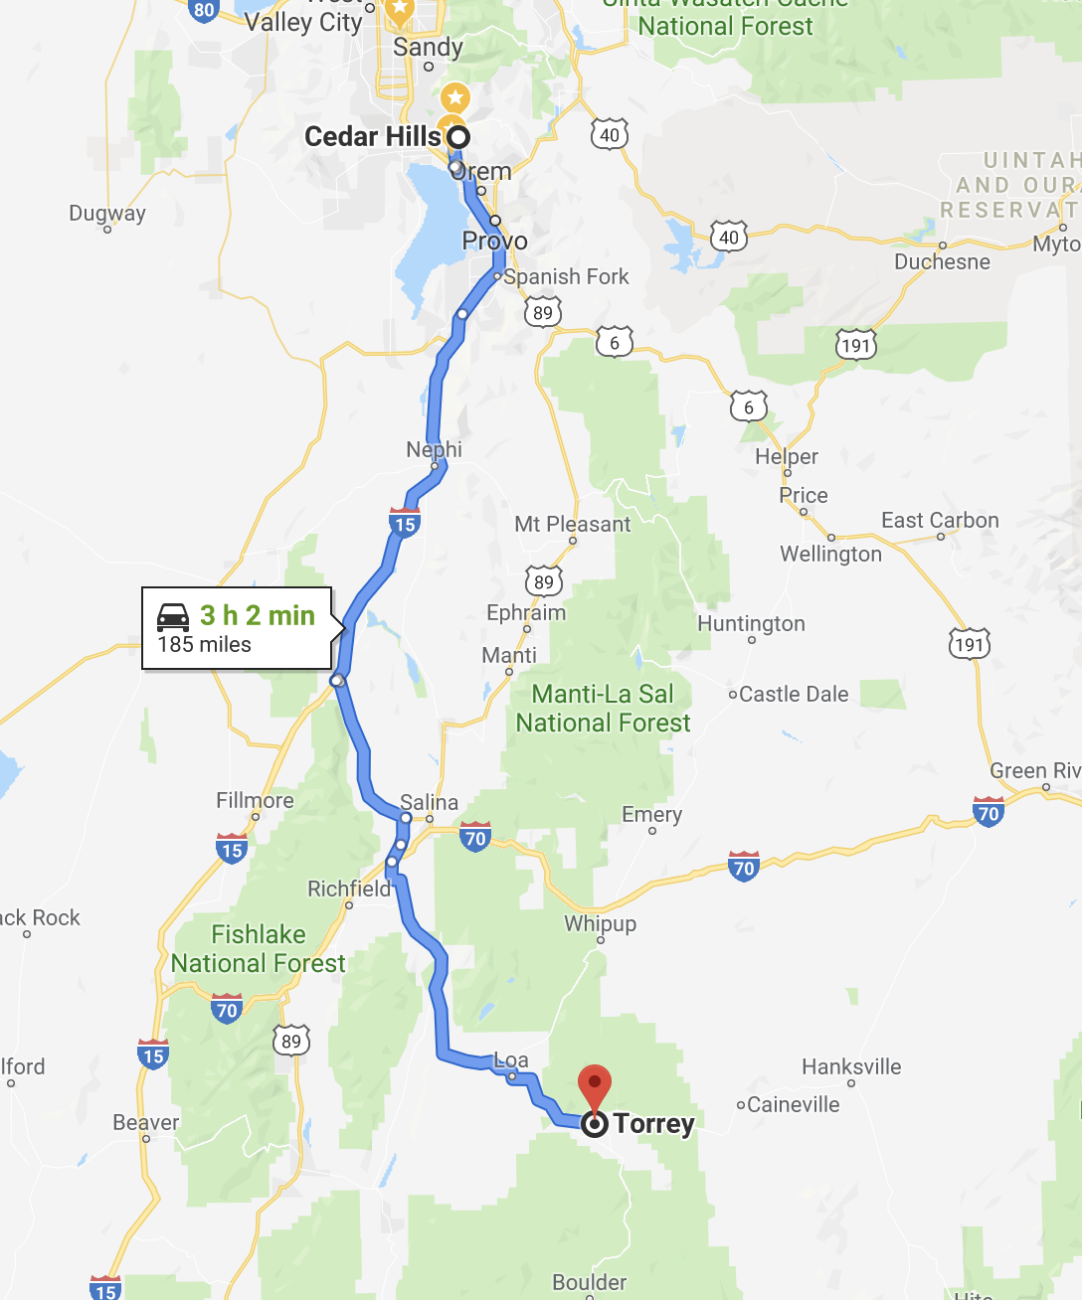
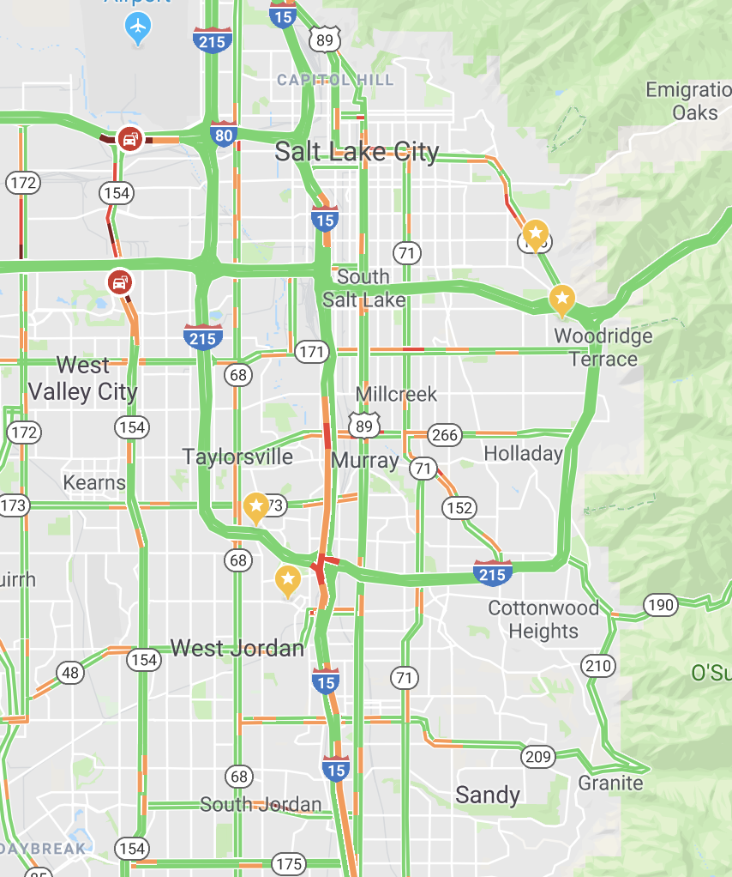
Lead vs lag – planning first trip
The first time we do the trip, we need lead information to determine a route and decide when to leave. There’s no other way to get this data.

Slide 21
Lag data collected during trips
Lag Data
Trip 1 – minute-by-minute log
Trip 2 – minute-by-minute log
Trip 3 – minute-by-minute log
Trip 4 – minute-by-minute log
…
Trip N – minute-by-minute log

Slide 22
Lag used to generate lead info
Lag Data
Trip 1 – minute-by-minute log
Trip 2 – minute-by-minute log
Trip 3 – minute-by-minute log
Trip 4 – minute-by-minute log
…
Trip N – minute-by-minute log
What time should we leave?
What happens if we take a different route?
Where can we stop along the way?
How can we use less gas?
What is the fastest trip time?

Slide 23
Summerhouse example shows how to go from strategy to KPIs and dashboards
KPIs are created to monitor progress and provide institutional memory
Lead and Lag information used to create a process and refine that process over time

Slide 24


